Slide 1
Unsupervised Machine Learning Final Project
DTSA 5510
Notes:
Save this document with a new name before you begin work.
When adding a new slide, click on the small arrow next to “New Slide” on the toolbar. Select the layout that will best fit the content you want to add.
Change the layout of an existing slide: click the “Layout” button on the top toolbar to reformat your existing content to another master slide.
Refer to utdallas.edu/brand for specific rules on using the University logos and wordmarks.

Slide 2

Overview – Cardio Good Fitness
Dataset: Cardio Good Fitness from Kaggle https://www.kaggle.com/datasets/saurav9786/cardiogoodfitness
Data collected from individuals who purchased a treadmill at a Cardio Good Fitness retail store
Unsupervised learning problem, no labels in the dataset
K Means Clustering Vs. Hierarchical Clustering

Slide 3
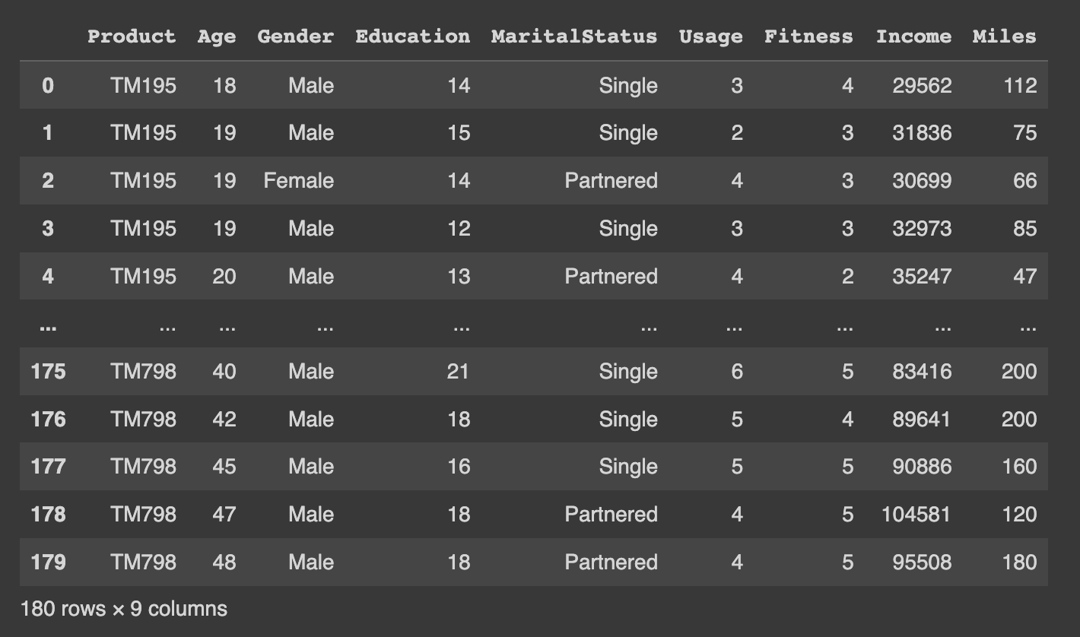
Exploratory Data Analysis (EDA)

Slide 4
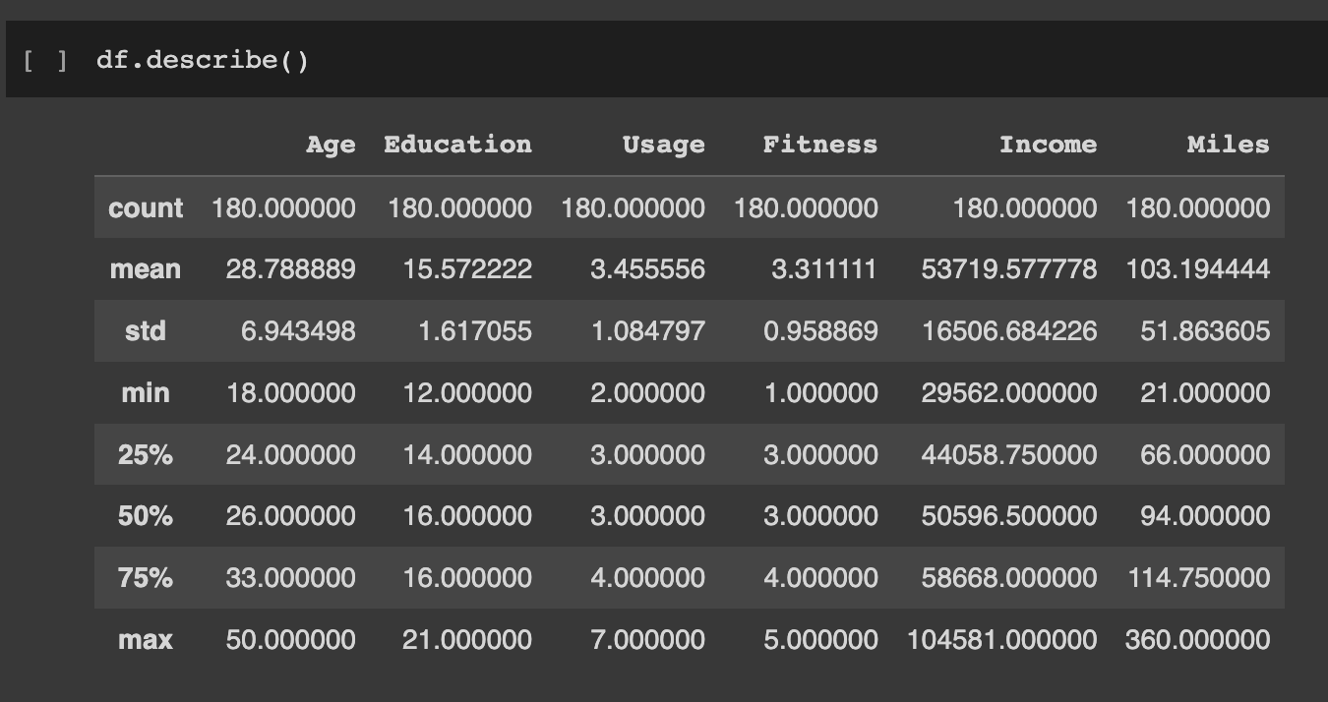
Exploratory Data Analysis (EDA)

Slide 5
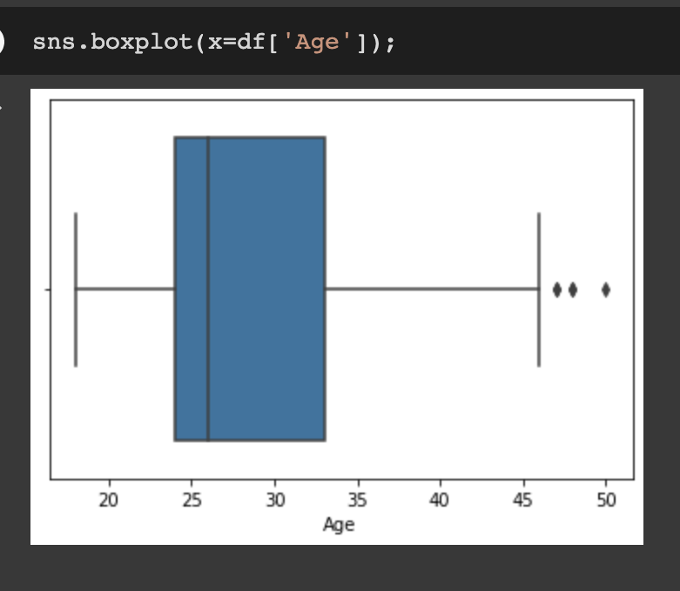
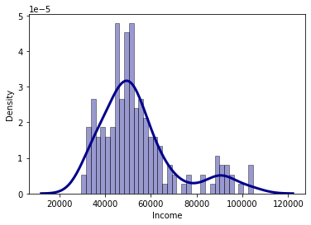
Exploratory Data Analysis (EDA)
Age
Income

Slide 6
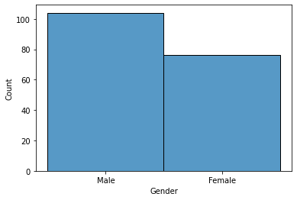
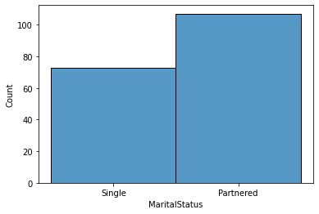
Exploratory Data Analysis (EDA)

Slide 7
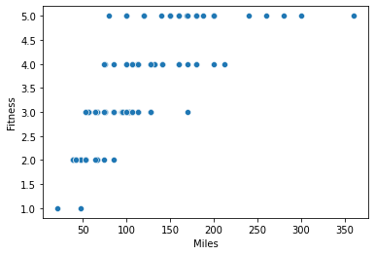
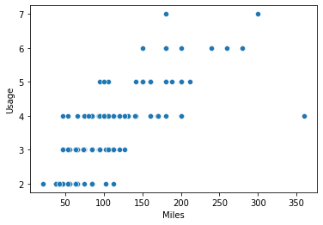
Exploratory Data Analysis (EDA)

Slide 8
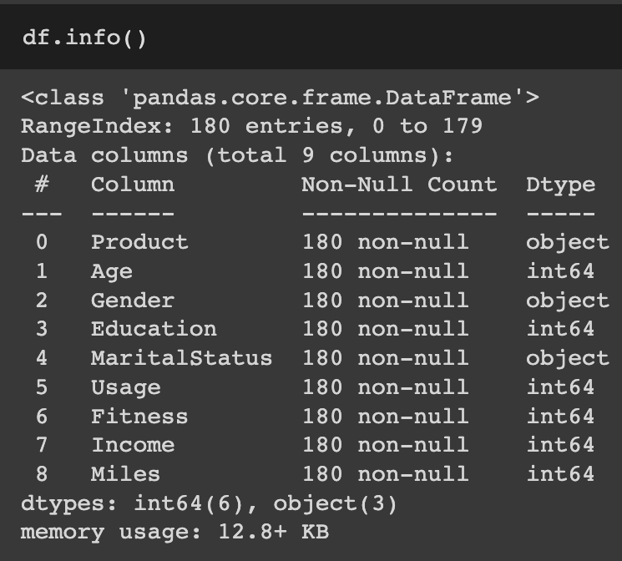
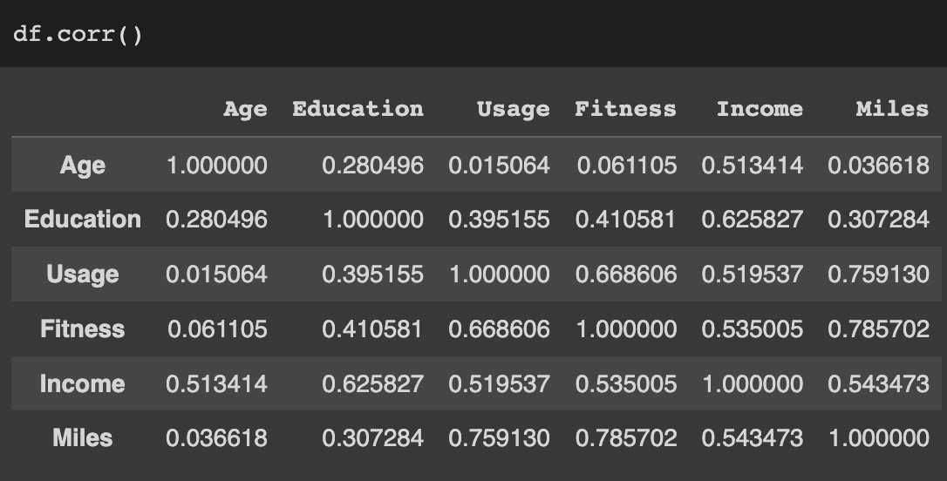
Exploratory Data Analysis (EDA)

Slide 9
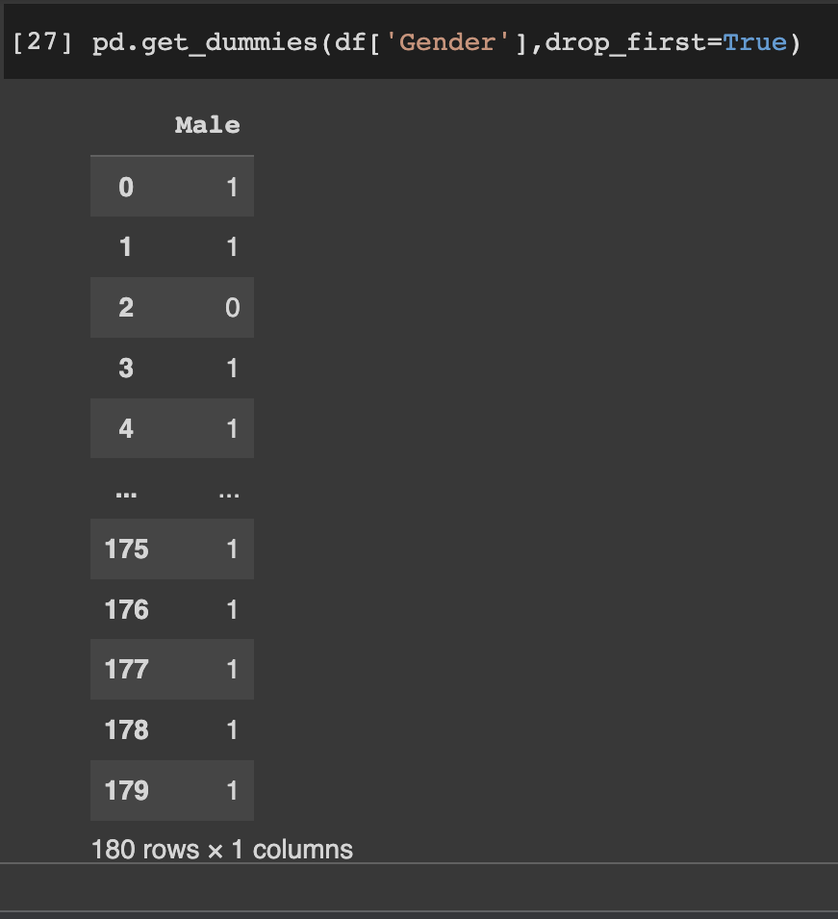
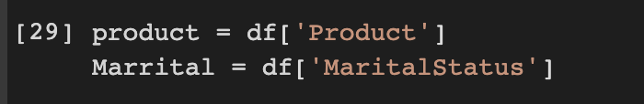
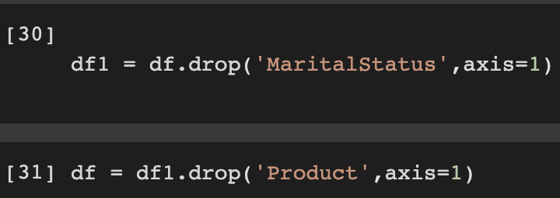
Exploratory Data Analysis (EDA)

Slide 10
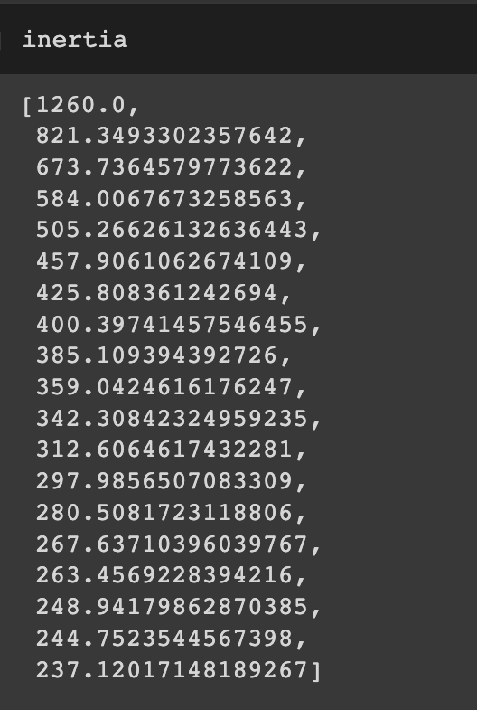
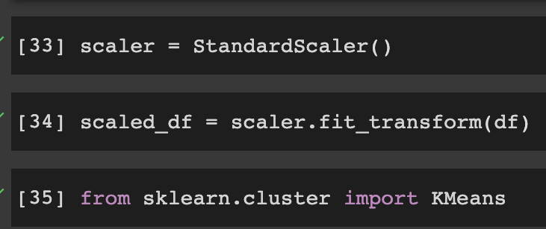
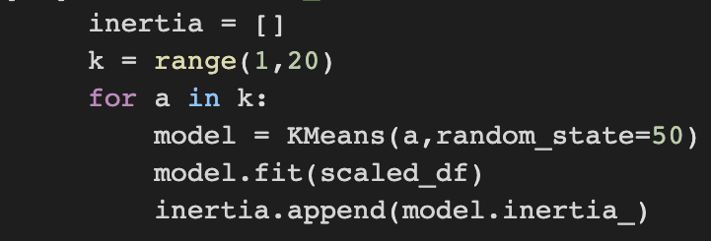
Models & Analysis – Kmeans Clustering

Slide 11
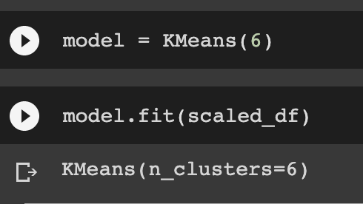
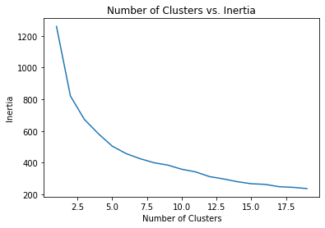
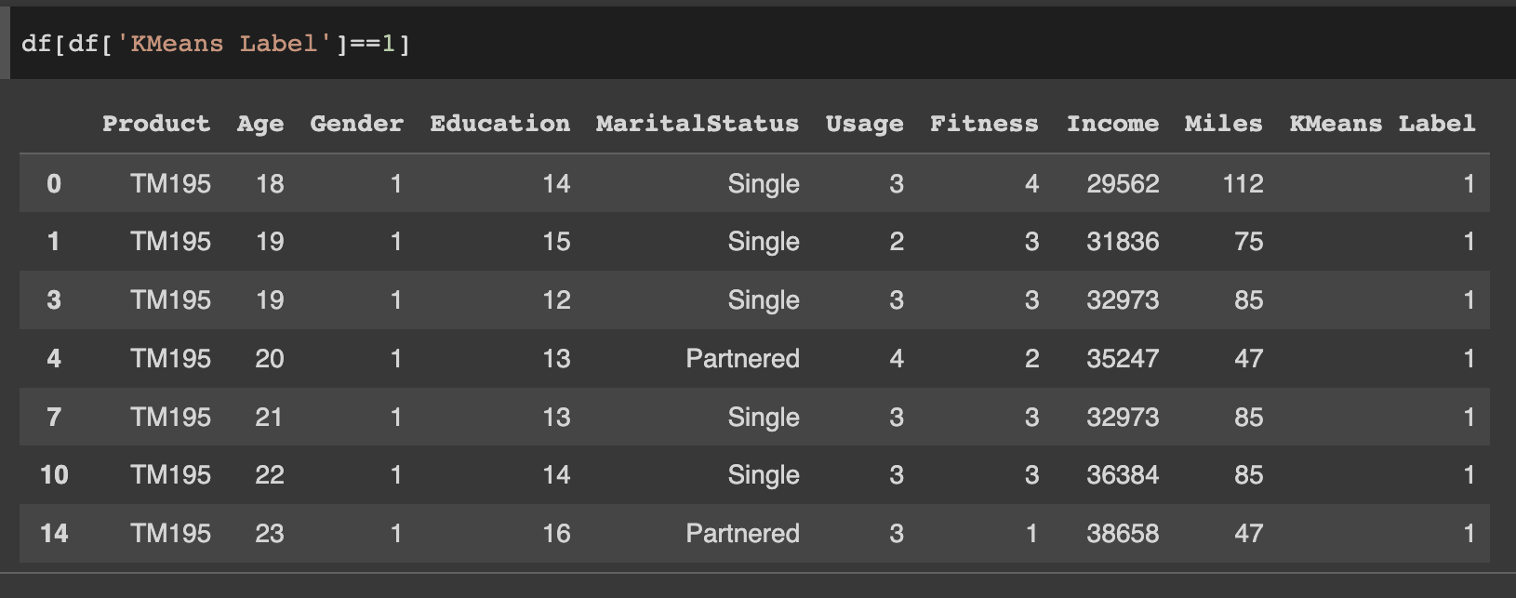
Models & Analysis – Kmeans Clustering

Slide 12
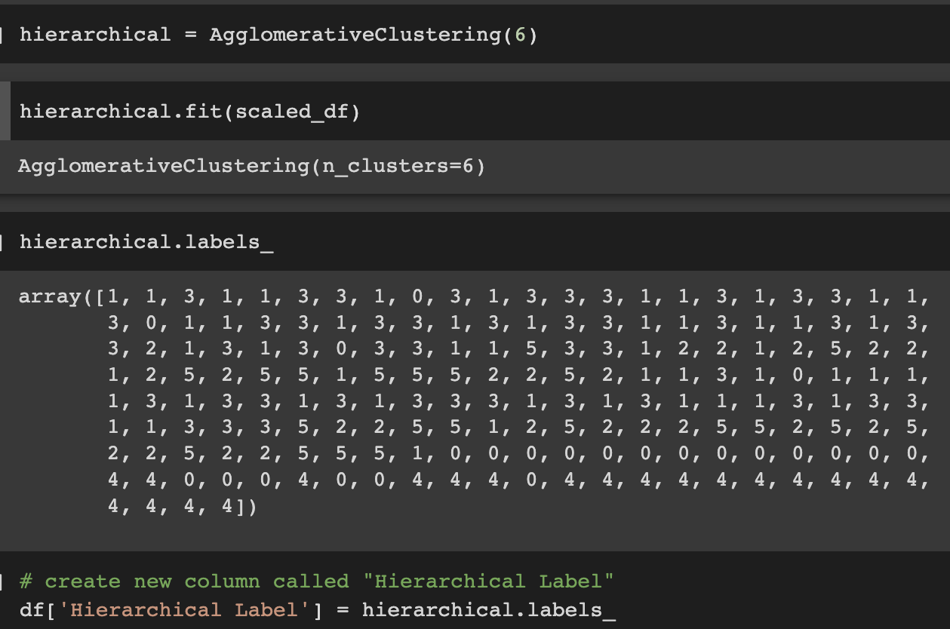
Models & Analysis – Hierarchical Clustering

Slide 13
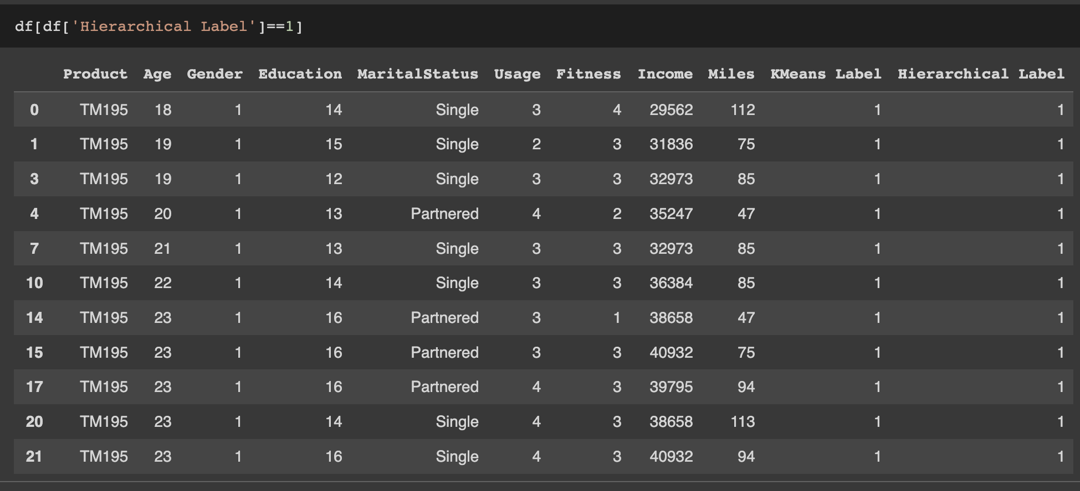
Models & Analysis – Hierarchical Clustering

Slide 14
Thank You !
DTSA 5510
Notes:
Save this document with a new name before you begin work.
When adding a new slide, click on the small arrow next to “New Slide” on the toolbar. Select the layout that will best fit the content you want to add.
Change the layout of an existing slide: click the “Layout” button on the top toolbar to reformat your existing content to another master slide.
Refer to utdallas.edu/brand for specific rules on using the University logos and wordmarks.

